Slide 1
Crowd Source Complaint Management System
Amrutha-2410030278
Lakshmi Sree-2410030279
Jyoshna Sree-2410030374
Poojitha-2410030453
Under the Guidance of
Mr.Chiranjeevi,
Mr.Aftab Yaseen
Course Instructor
Computer Science and Engineering Department
KL Hyderabad Off Campus, Aziz Nagar ,Hyderabad

Slide 2
Overview
Introduction
Objectives of the Project
Tools we used in our implementation
Screenshots of the Project
Project links
Conclusion

Slide 3
Introduction
Our project is a web-based system for submitting the complaints
Submit all your college-related complaints in one place.
Quick & Easy: Report an issue in just a few minutes.
Track Real-Time: Follow your complaint's status from start to finish. Pending,In Progress,Resolved
Ensures the right department addresses your concern.

Slide 4
Objectives of the Project
To create a digital platform for students and staff to easily report and monitor academic, and hostel-related issues.
To ensure complete transparency by allowing students to track the status of every complaint from submission to resolution.
To streamline administrative workflow by automatically routing complaints to the relevant departments (e.g.,hostel, academics,canteen ), reducing manual effort and delays.
To help students and the college work as a team to solve problems.
To make sure no complaint is forgotten or ignored by keeping a permanent record until it is solved.

Slide 5
TOOLS WE USED IN
OUR IMPLEMENTATION
FRONTEND
HTML5 - Semantic structure, forms, and input validation
CSS3 - Modern styling with Flexbox, Grid, animations, and gradients
JavaScript - DOM manipulation, Local Storage, and form handling
Bootstrap 5 - Responsive grid system and UI components
Font Awesome - Icons and status indicators throughout the interface
BACKEND
Node.js - JavaScript runtime environment for server-side execution
Express.js - Web framework for REST API, routing, and middleware
MongoDB - NoSQL database for document storage and collections
Mongoose - ODM library for data modeling and validation
JWT - Token-based authentication for secure user sessions
bcrypt - Password hashing for enhanced security
Multer - Middleware for handling file and image uploads

Slide 6
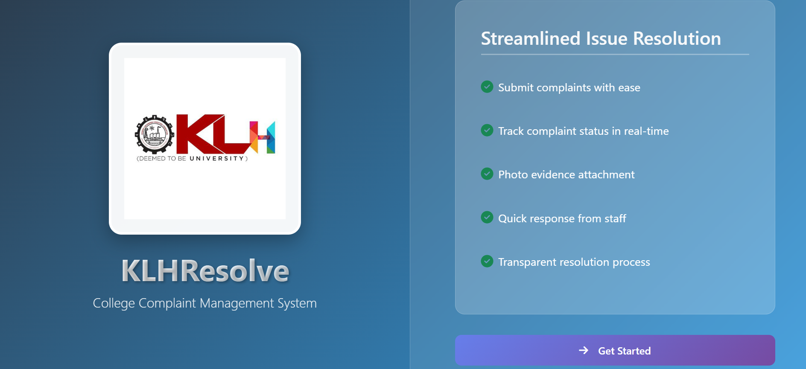
ScreenShot-1

Slide 7
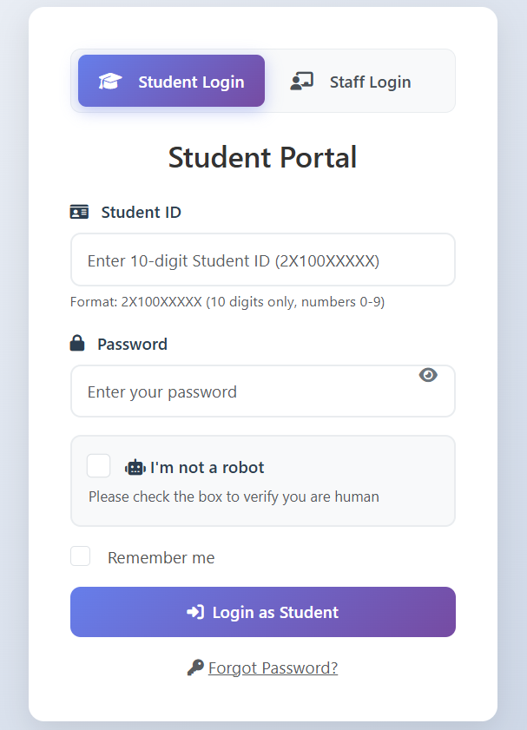
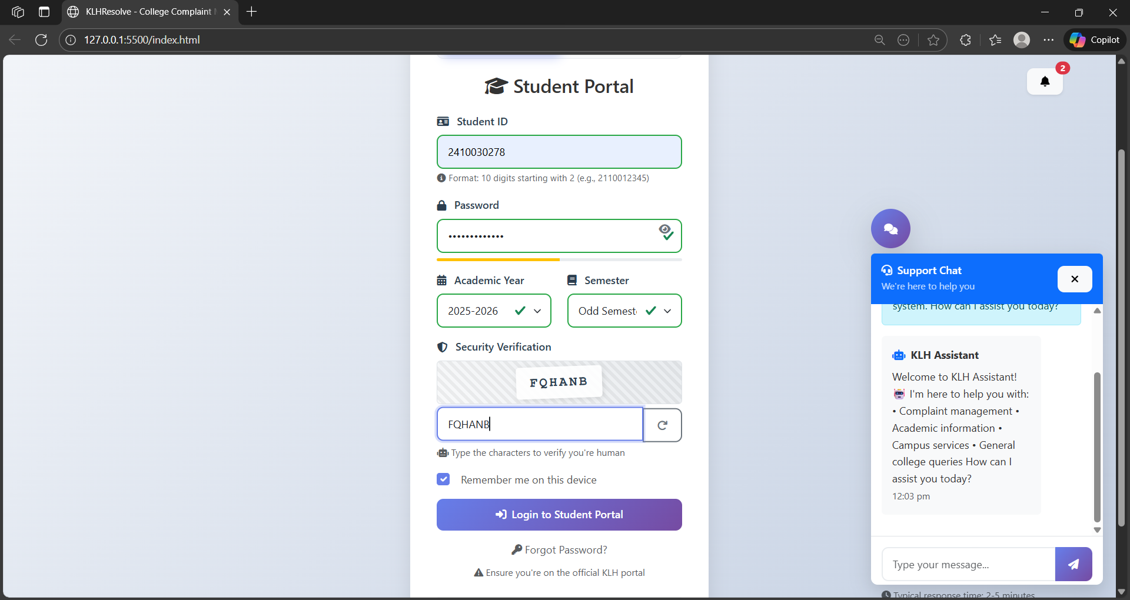
ScreenShot-2
ScreenShot-3

Slide 8
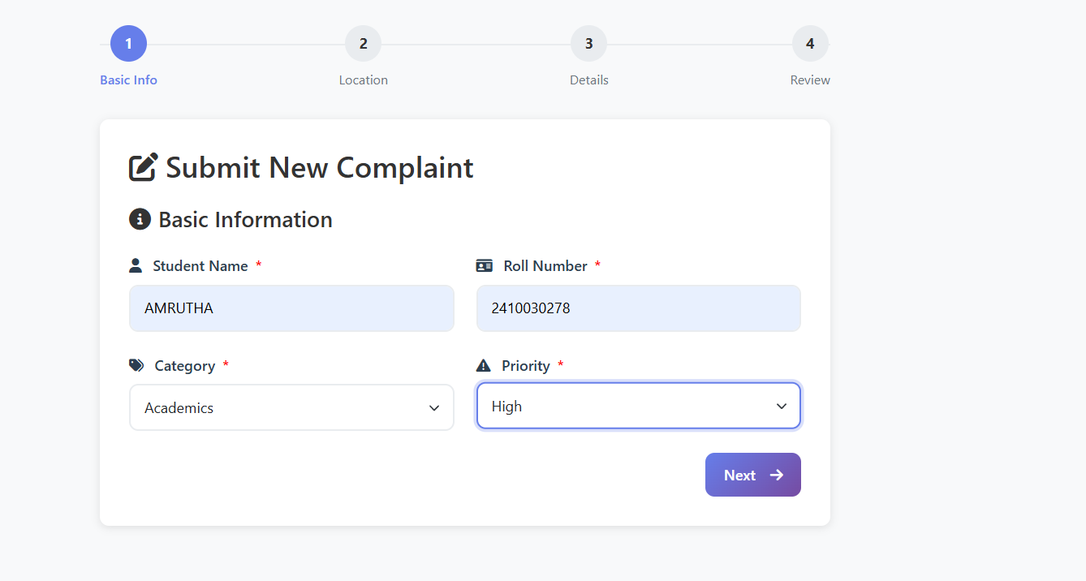
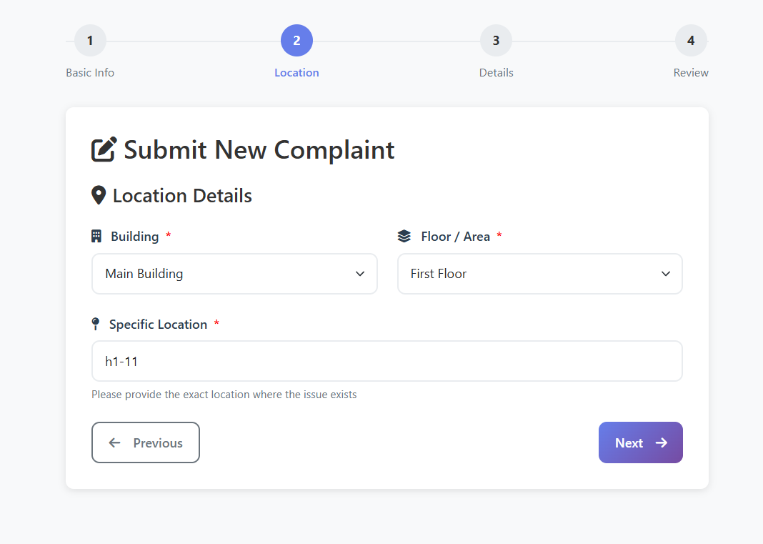
ScreenShot-4
ScreenShot-5

Slide 9
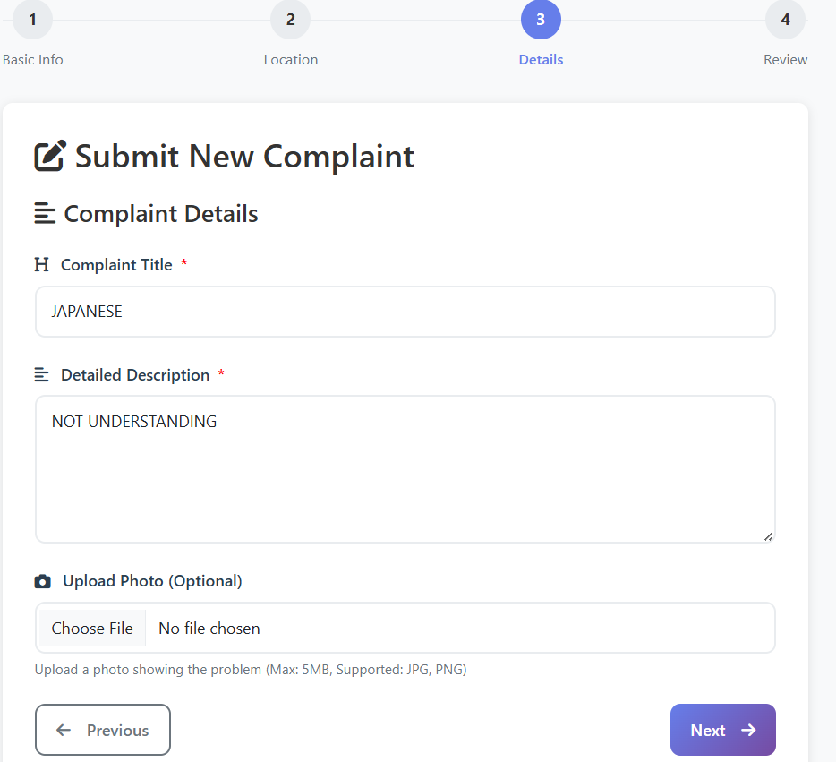
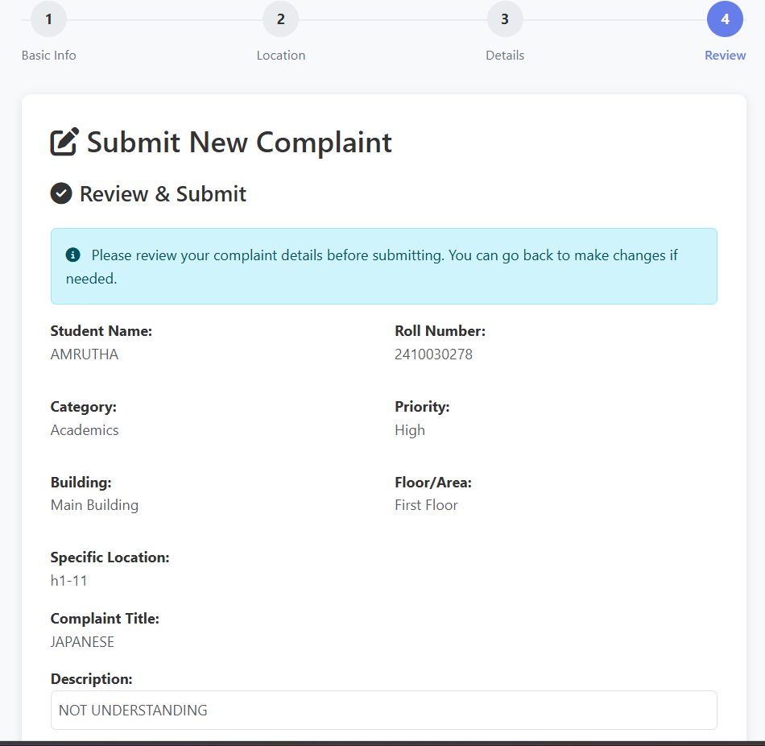
ScreenShot-6
ScreenShot-7

Slide 10
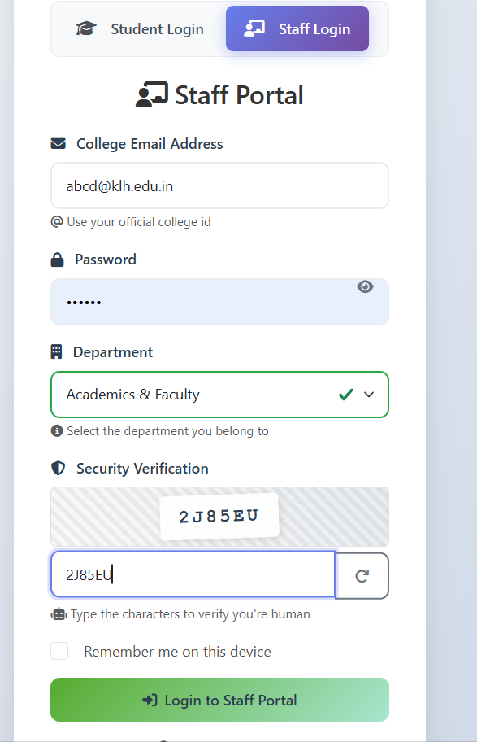
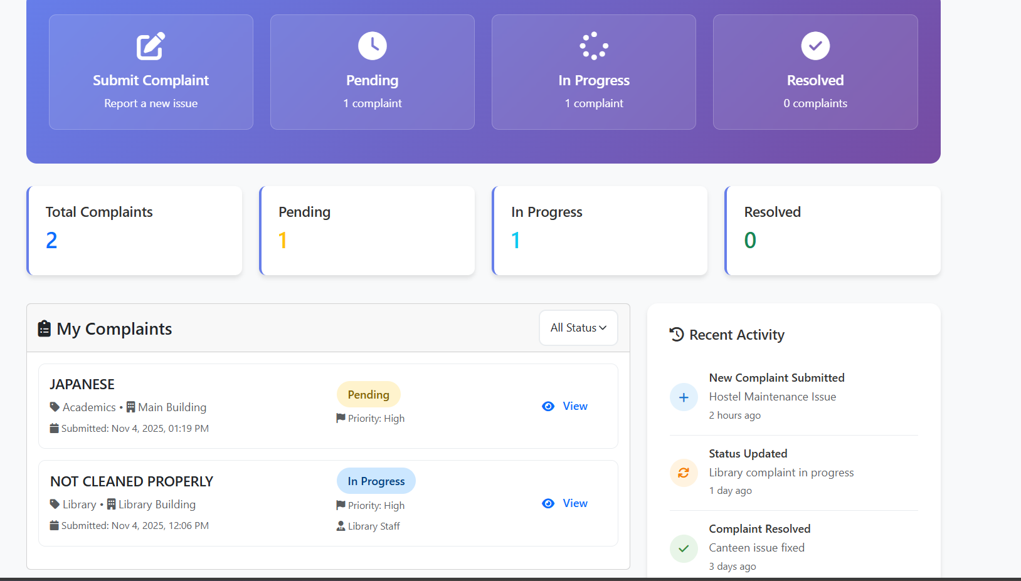
ScreenShot-8
ScreenShot-9

Slide 11
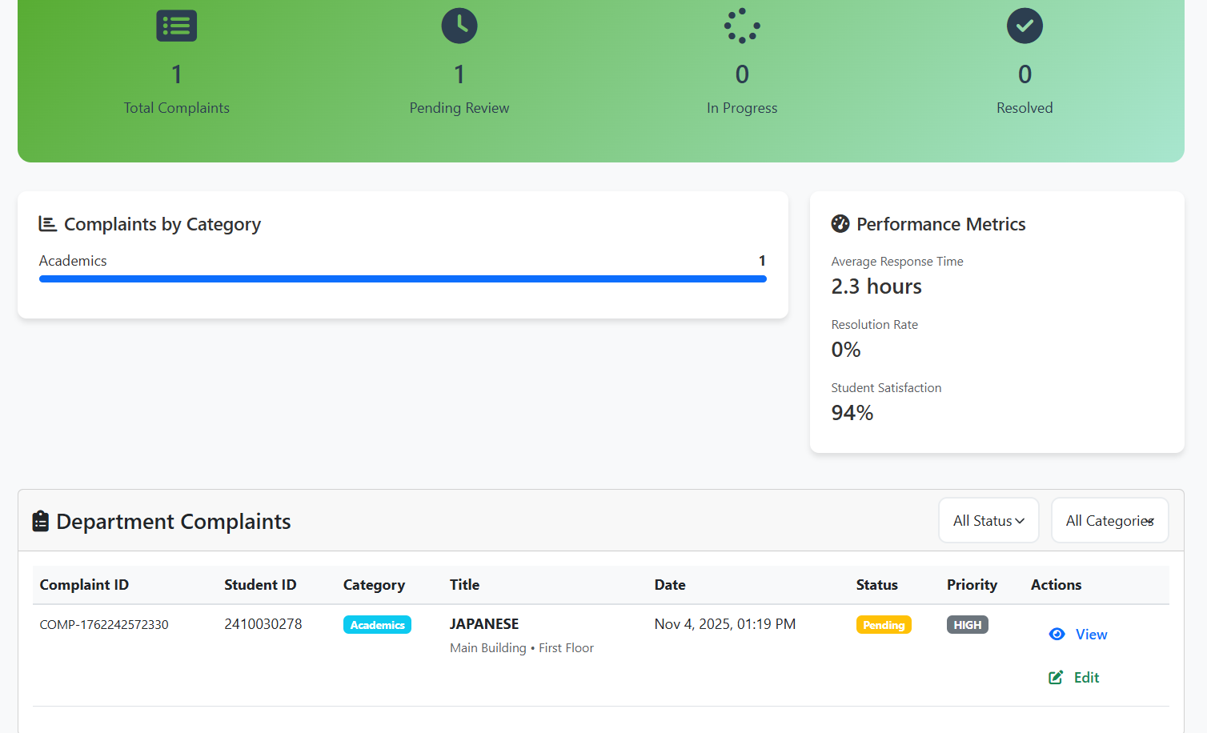
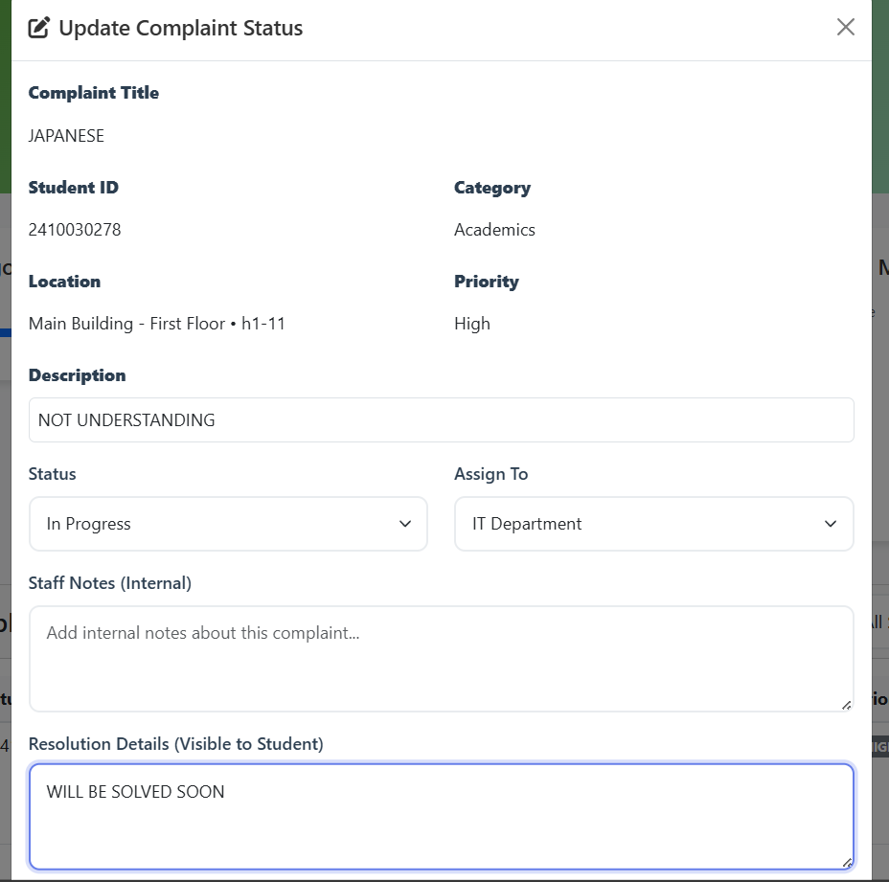
ScreenShot-10
ScreenShot-11

Slide 12
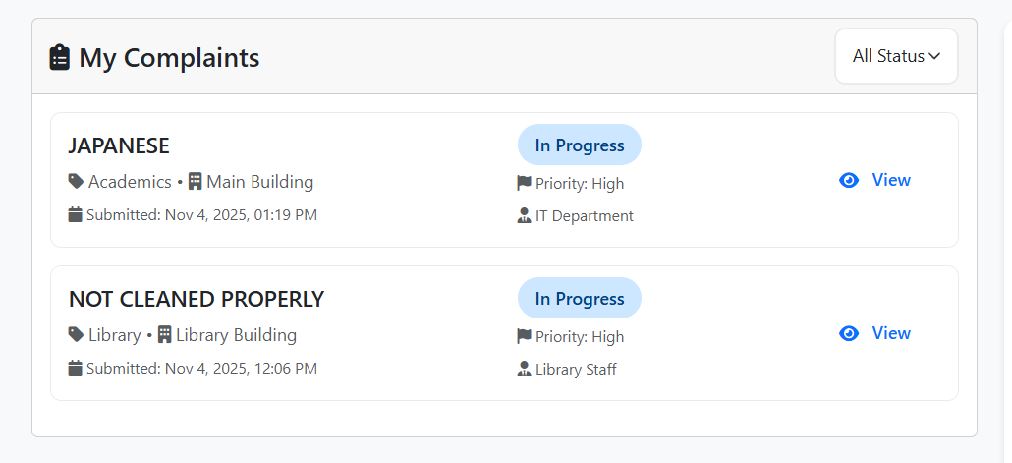
ScreenShot-12

Slide 13
GitHub/Repository Link : https://github.com/SistuAmrutha/Crowd-Source-Complaint-Management-System-
Rendor Link : https://crowd-source-complaint-management-system-eydi.onrender.com

Slide 14
Conclusion
The KLHResolve - College Complaint Management System successfully addresses the critical need for an efficient, transparent, and user-friendly platform to manage student complaints in educational institutions. Through our implementation, we have demonstrated how technology can bridge communication gaps and create a more responsive administrative system.

